Slide 1
Children’s Law Center of Minnesota
Legal Representation of Foster Care Youth
Lilia Panteleeva, Executive Director

Slide 2
RIGHT TO COUNSEL MINNESOTA
Minnesota Statutes provide for the following rights of a child who is subject to a juvenile court proceeding under 260C, Juvenile Safety and Placement Procedures:
A right to participate in all proceedings on a petition.
An opportunity to personally attend all hearings.
A right to effective assistance of counsel.
And if a child desires counsel, the court shall appoint counsel to represent the child who is ten years of age or older, in any case in which it feels that such an appointment is appropriate.
Minnesota Statute 260C.163

Slide 3
APPOINTMENT OF COUNSEL SURVEY RESPONSES
Over 13 years old
Over 12 years old
At the request of GAL
When a child asks for one
Only in runaway cases
Judge’s discretion
If petition is based on child’s actions
When child expresses opinion significantly different from GAL
Not state-wards / Some state-wards

Slide 4
CHILDREN IN FOSTER CARE ARE NOT INVISIBLE CHILDREN
Children in foster care are in the system through no fault of their own, yet they suffer poor outcomes:
47% report being unemployed one year after aging out of foster care.
45.4% report living on food stamps two to three years after aging out.
44.6% (male) and 16.4% (female) former foster children are incarcerated after aging out.
30.7% who grow up in foster care graduate from high school.
27% experience homelessness within a year after aging out of foster care.
3% have a bachelor degree.
Source: American Bar Association

Slide 5
WHY DO FOSTER CHILDREN NEED LAWYERS?
Lawyers allow children to have a voice in a proceeding that affects them the most.
Foster children need to be protected from being further retraumatized by the system.
Navigating child welfare court system is complicated and confusing.
Foster children are often not aware of the services and support to which they are entitled – lawyers hold the system accountable.
Lawyers help inform, counsel and empower children which help them make better decisions.
Judges can make better decisions when they have all the information and receive more options when lawyers craft creative solutions.
Lawyers lead to less youth “crossing over” into the delinquency system or running away which saves money.
Foster children have lives beyond 18 – a lawyer can help protect their future.
Foster children should have a lawyer even (and especially) after their parents’ parental rights have been terminated and they become state-wards.
If the accused abusers get a lawyer – why shouldn’t the abused and neglected children?

Slide 6
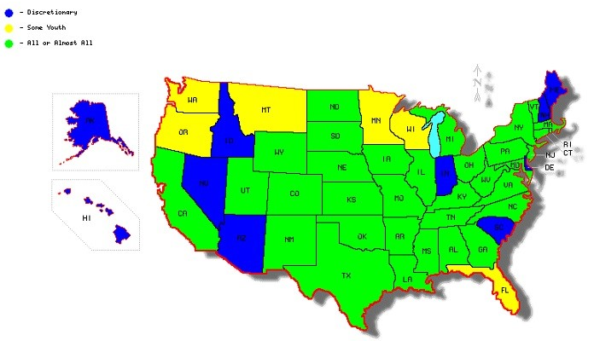
APPOINTMENT OF COUNSEL 50 STATE COMPARISON

Slide 7
WHAT CAN WE DO?
Ensure that children are properly informed of their right to counsel and receive effective representation by attorneys who have adequate time and resources to handle each case;
Require specialized, multi-disciplinary training for children’s attorneys (legal training, specific to abuse and neglect proceedings and specialized, multi-disciplinary training so the lawyer understands how to work with children and can effectively counsel them);
Ensure that a child is a party to the proceedings and can be heard from directly (if the child so desires after being counseled by a competent, trained attorney);
Require reasonable caseload limits for attorneys representing children so as to encourage effective, competent representation;
Encourage collaboration with other parties (the county attorneys, parents’ attorneys, SW, GAL) to ensure sustainable resolution of the case;
Ensure that legal representation continues as long as the court maintains jurisdiction over the case, including all periods of foster care or other residential placement, as well as the process of the child’s transition to adult independence.

